Slide 1


Slide 2
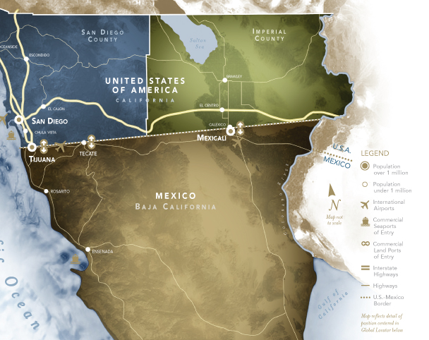

Slide 3
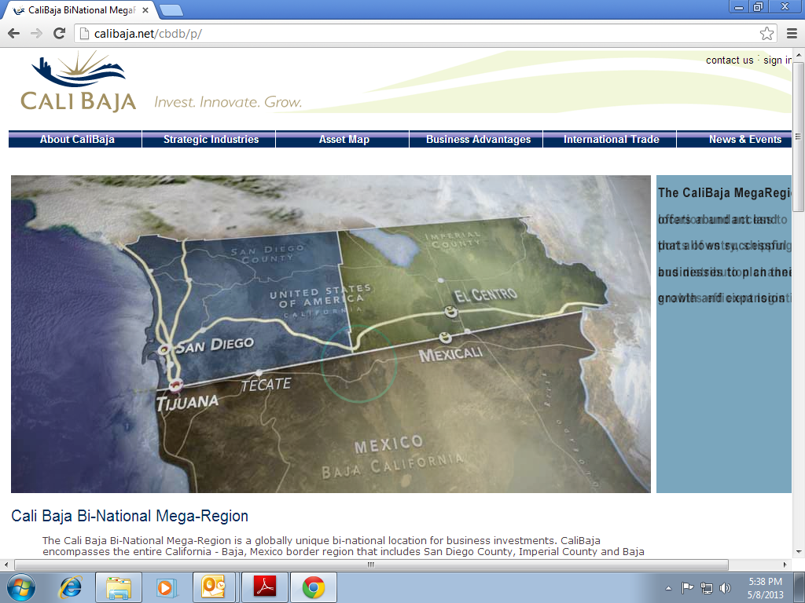
www.calibaja.org – home page

Slide 4
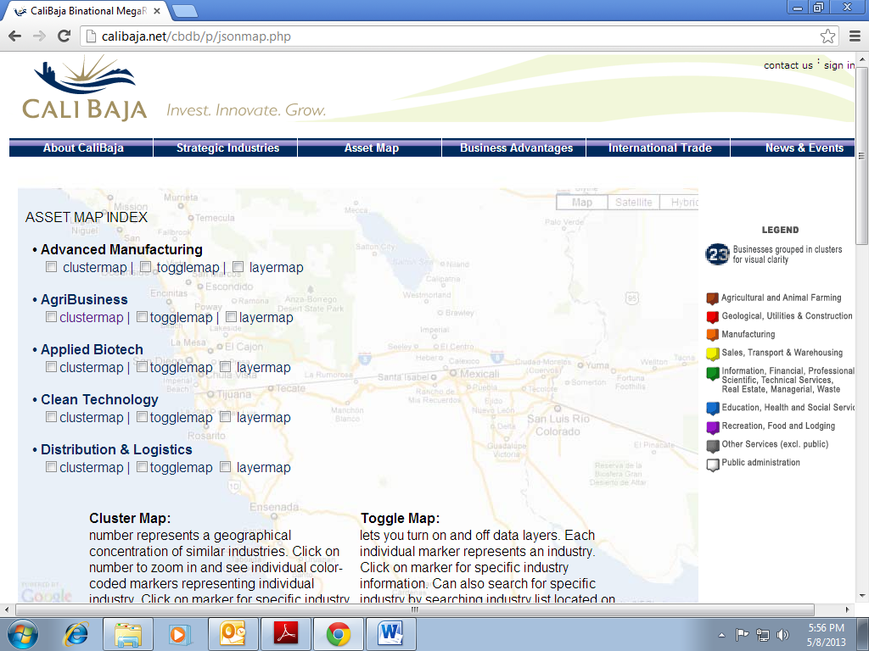
Asset Map - Index

Slide 5
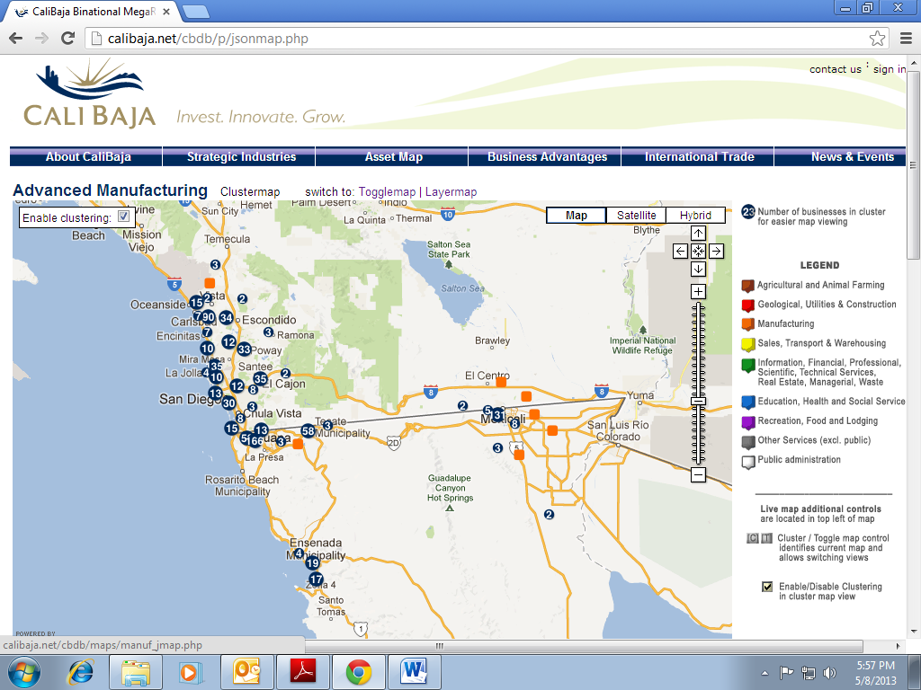
Advanced Manufacturing-Clustermap

Slide 6
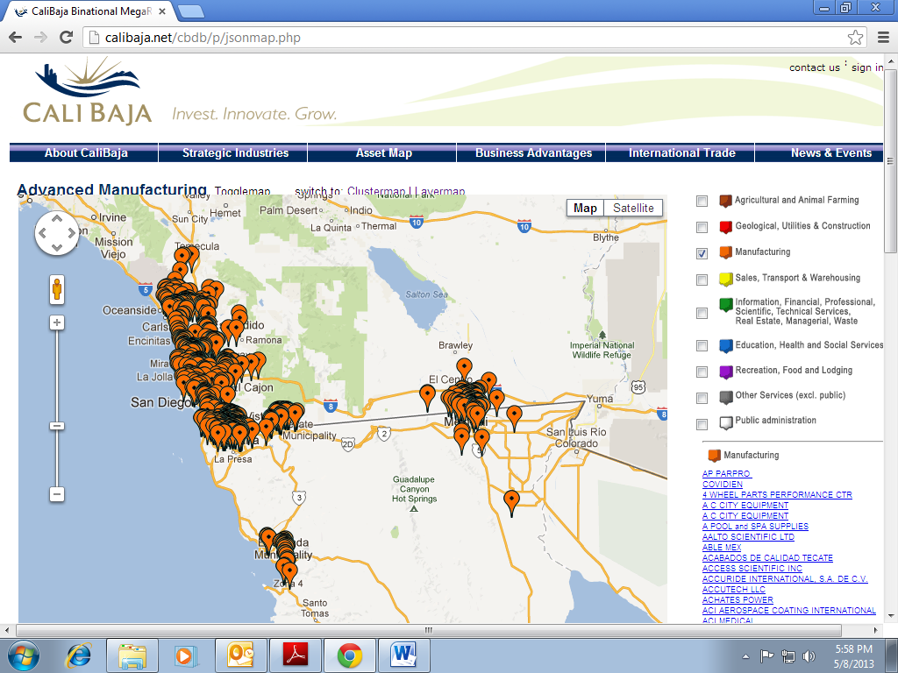
Advanced Manufacturing - Togglemap

Slide 7
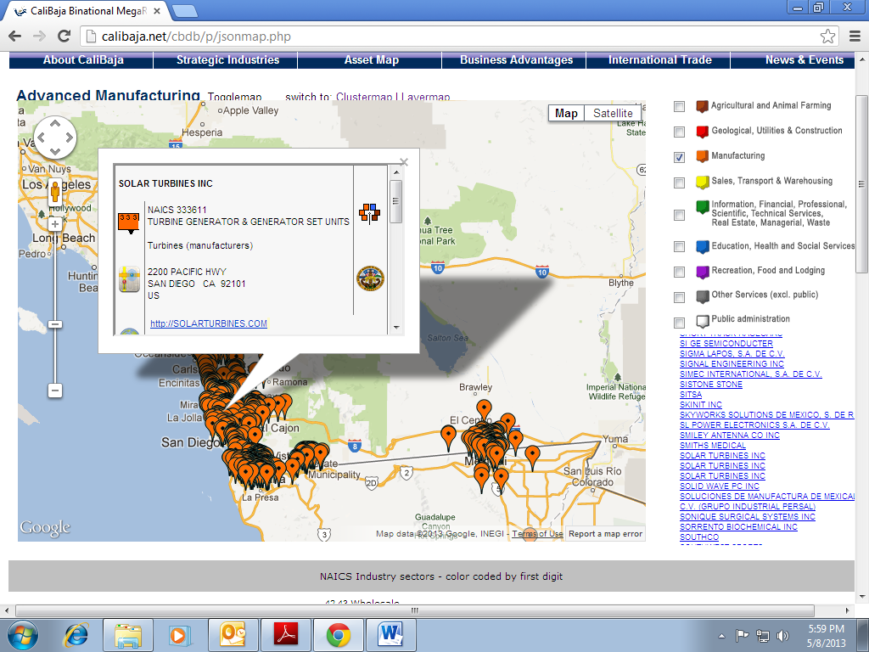
Industry Information

Slide 8
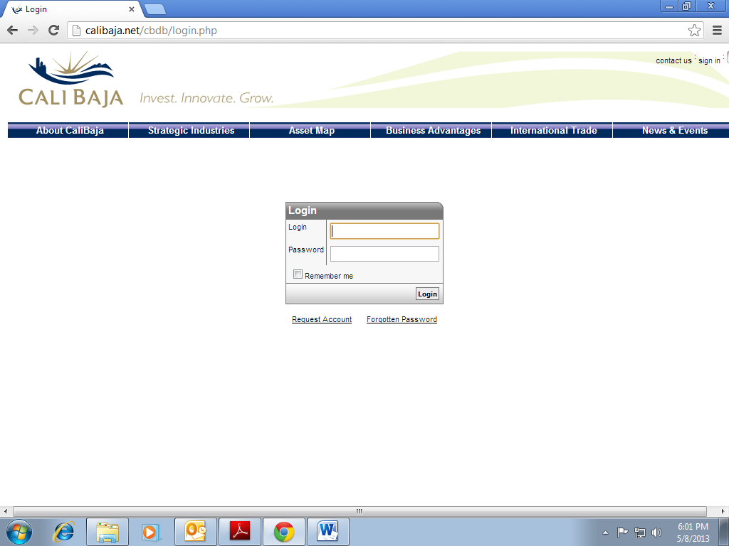
Login for more detailed information

Slide 9
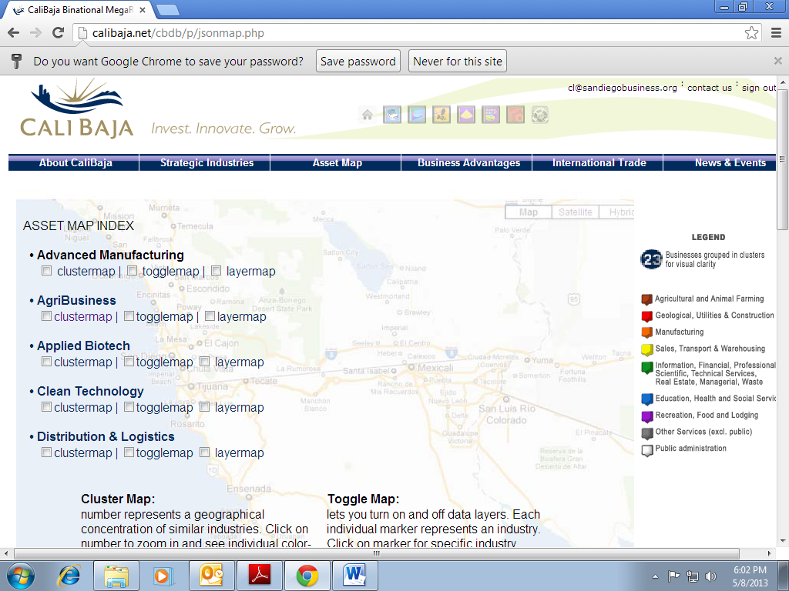
Use Icons for more in depth info

Slide 10
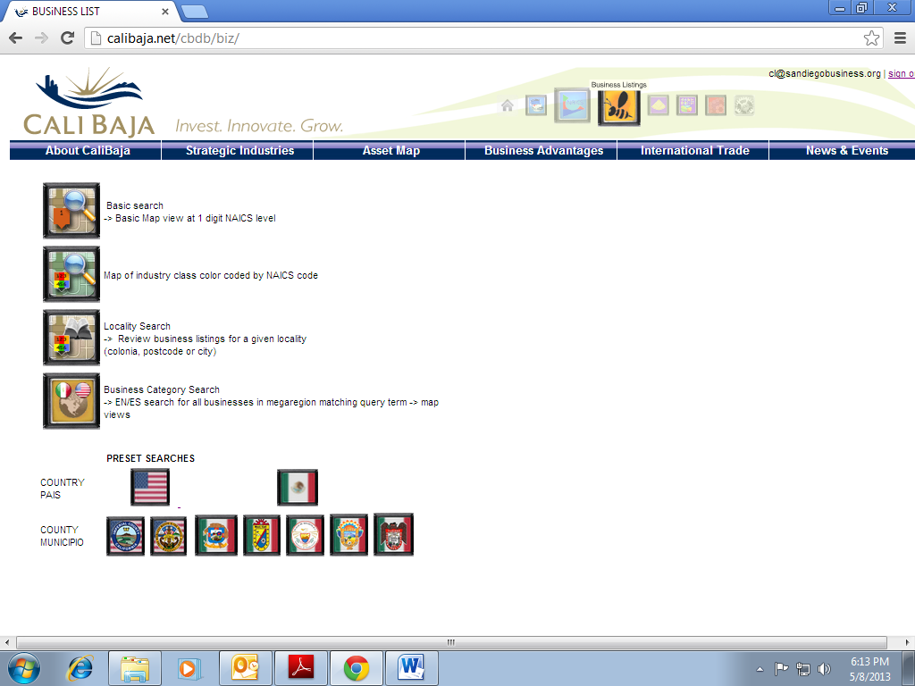
Bee Icon - Business Listings

Slide 11
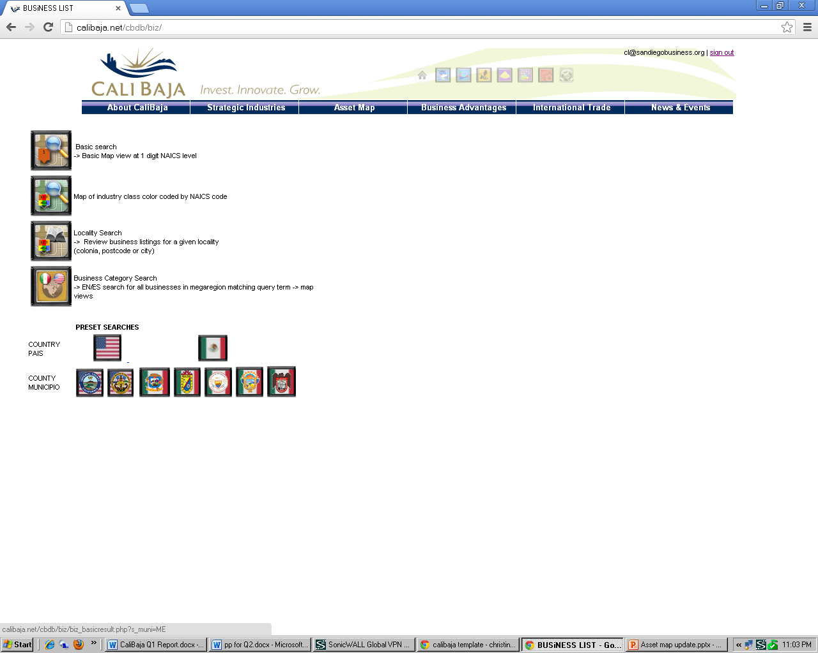
Business Listings – Select Map

Slide 12
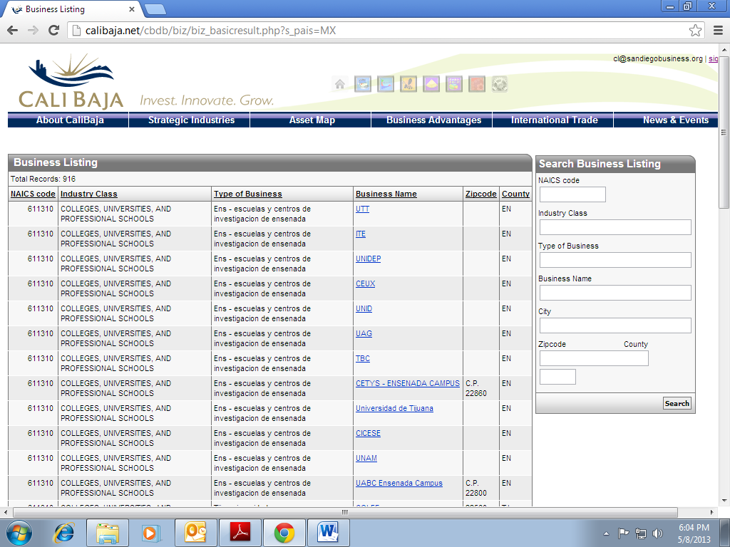
Total Records

Slide 13
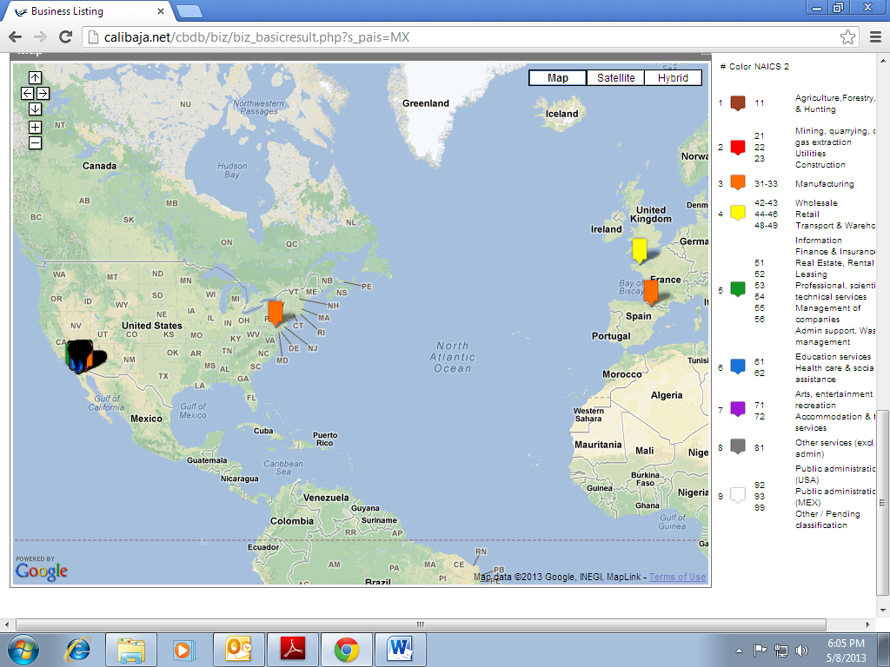
Map at bottom of page

Slide 14
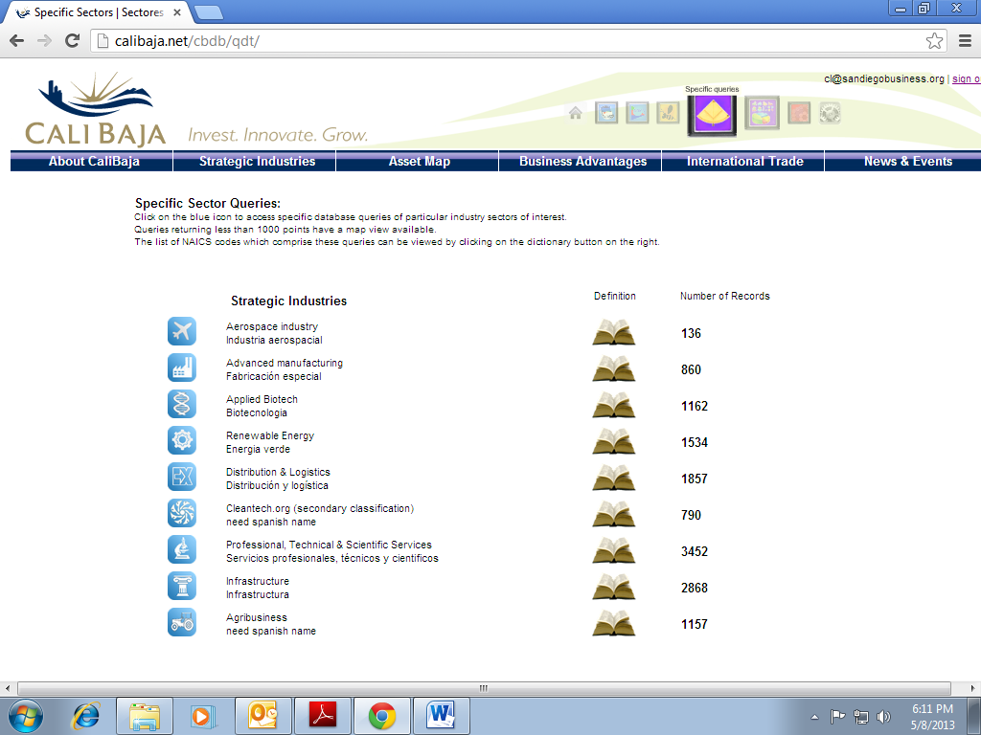
Specific Inquiries Icon

Slide 15
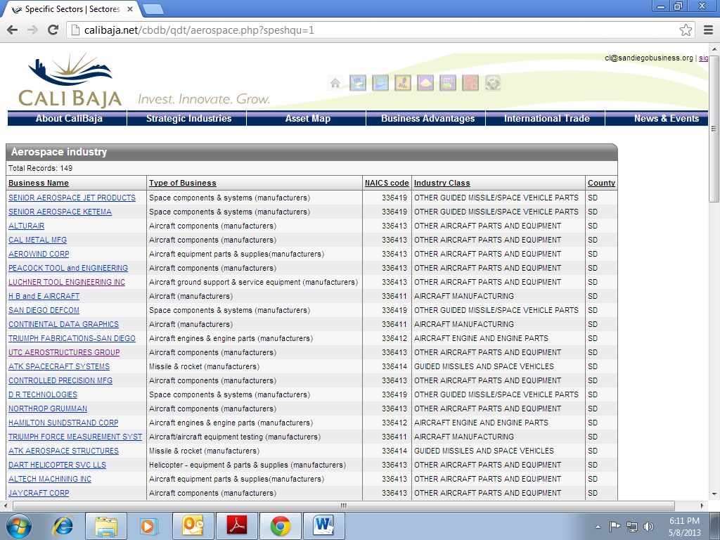
Aerospace

Slide 16
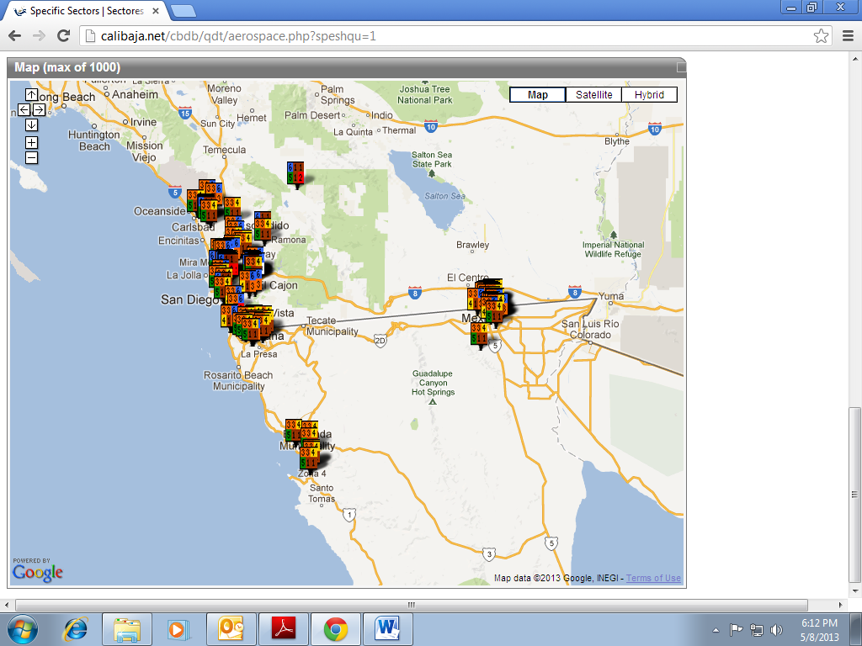
Map with pins

Slide 17
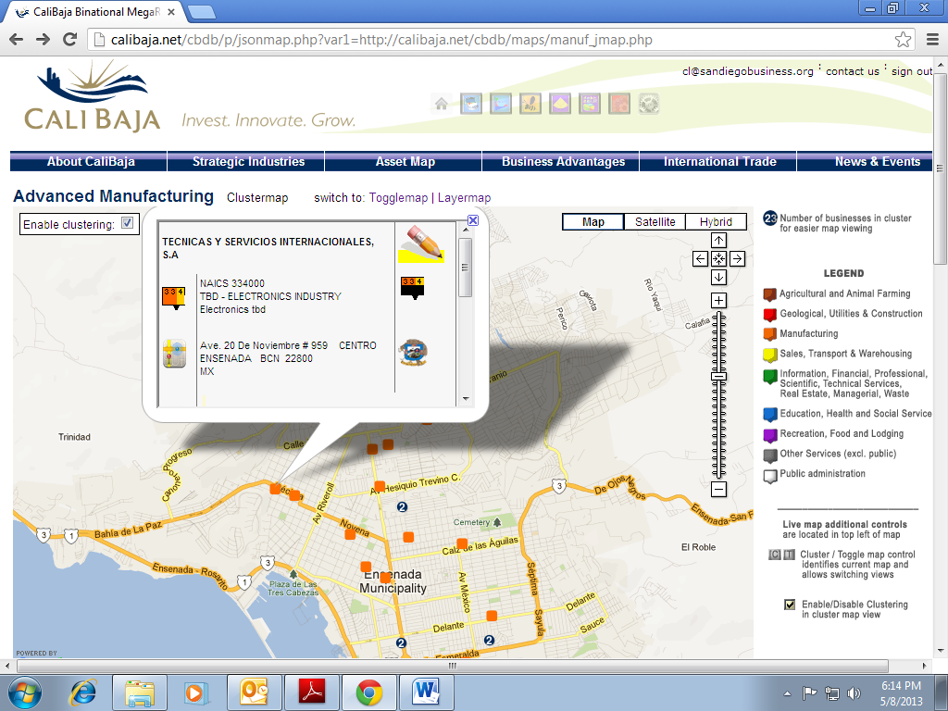
Editing Company Information

Slide 18
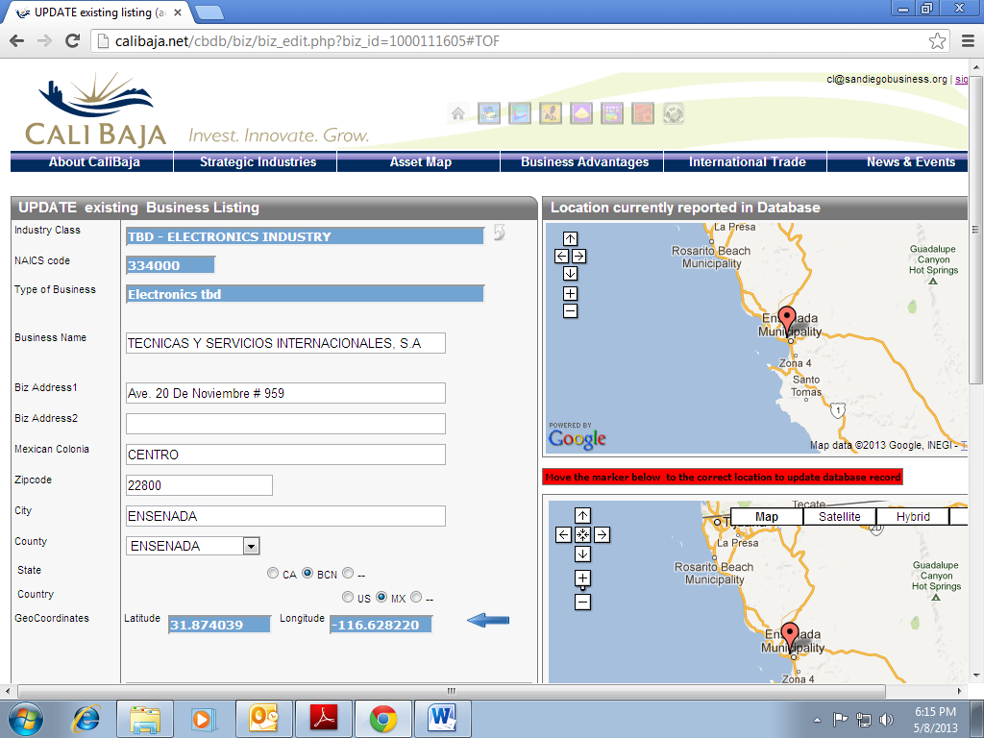
Data Field

Slide 19
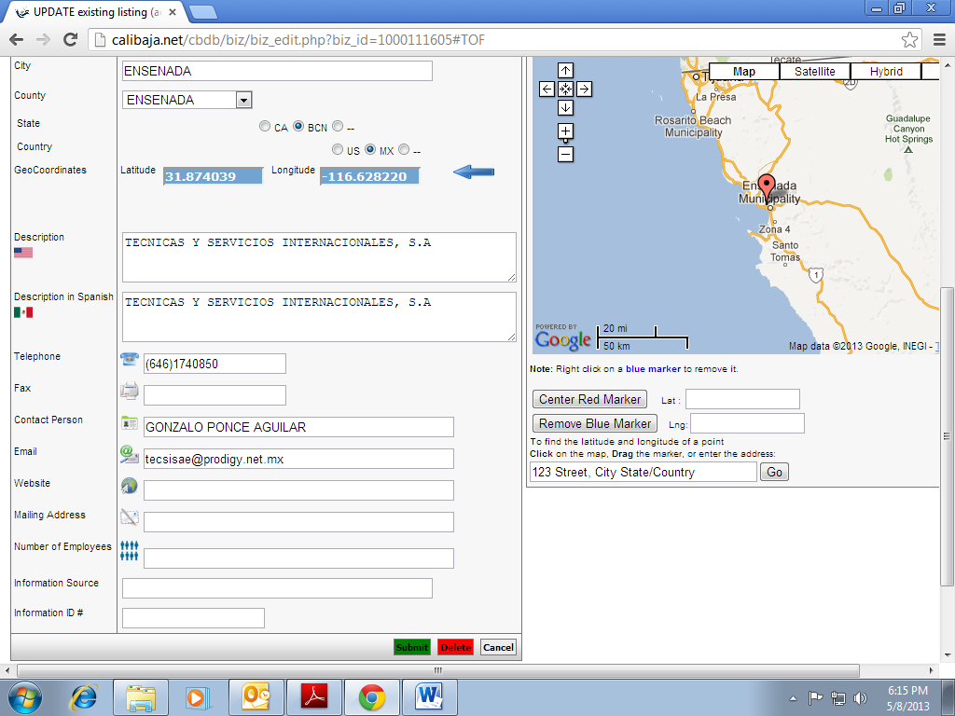
Data Field

