Slide 1


Slide 2
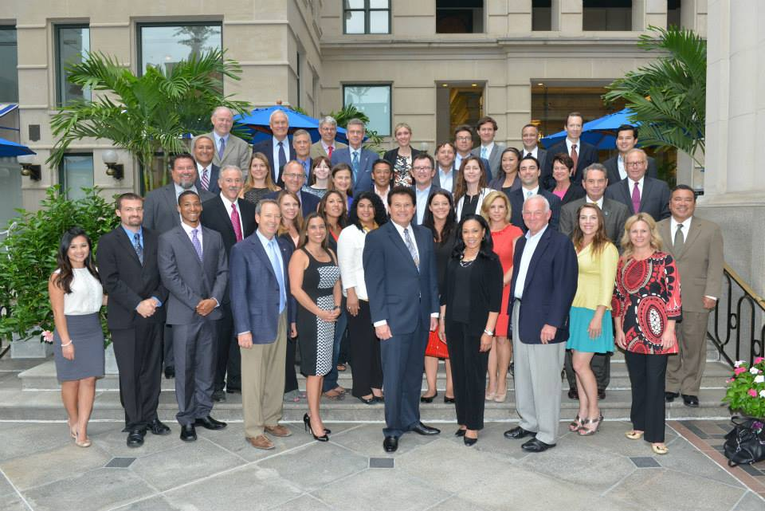
2014 Delegation

Slide 3
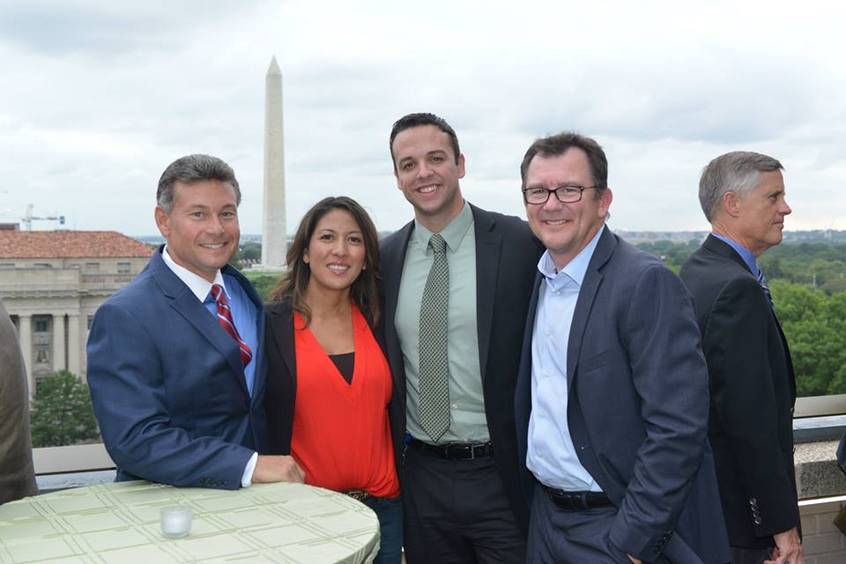
Reception at Carr Workspaces

Slide 4
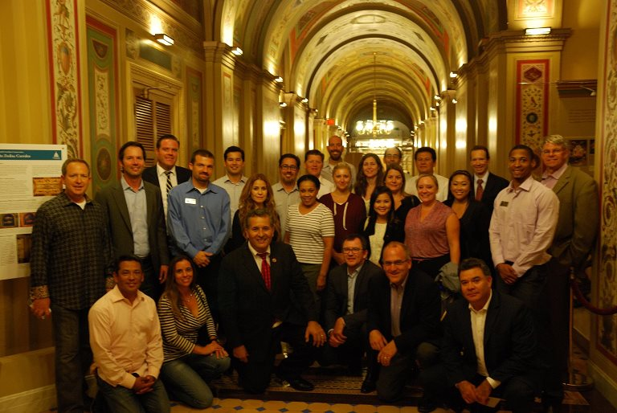
Twilight Capitol Tour with Rep. Juan Vargas

Slide 5
Meetings Included:
    US Department of Health & Human Services
    Sean Cavanaugh, Deputy Administrator, Centers for Medicare & Medicaid Services
    US Chamber of Commerce
    Mexican Embassy
    House Committee on Education and Workforce
    Office of Majority Whip Steve Scalise

Slide 6
Meetings Included:
    Department of Housing and Urban Development
    General Services Administration – Commissioner Norman Dong
    Customs & Border Protection – Commissioner Kerlikowske, Deputy Commissioner McAleenan, and Department of Homeland Security Acting Assistant Secretary

Slide 7
Meetings Included:
    Department of Commerce – Deputy Assistant Secretary, Walter Bastian
    Department of State – Deputy Assistant Secretary, Susan Saarnio
    Federal Highway Administration Freight and Management Operation
    White House Office of Science and Technology Policy

Slide 8
Meetings Included:
    Assistant U.S. Trade Representative, Jewel James
    Rep. Bill Shuster (R-PA), Transportation and Infrastructure Committee Chair
    Congressmembers Beto O’Rourke (TX), Henry Cuellar (TX), Jeff Denham (CA), Devin Nunes (ca), David Valadao (CA), Grace Napolitano (TX), Filemon Vela (TX)

Slide 9
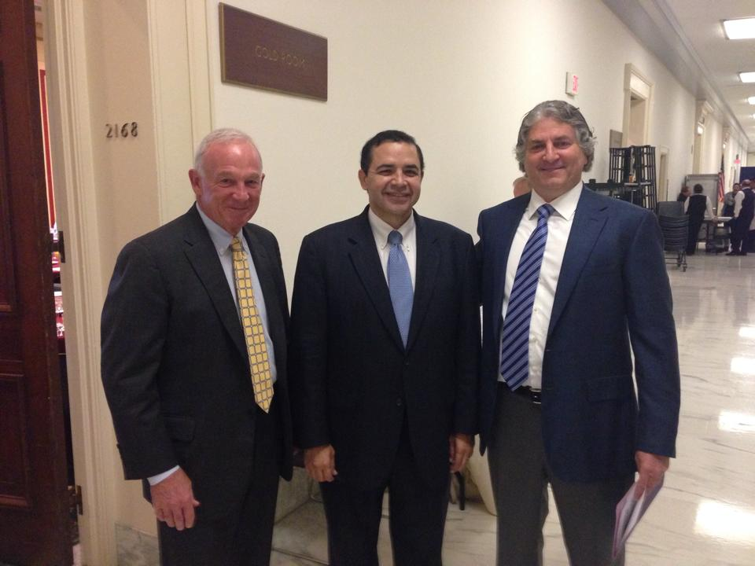
Jerry Sanders, Rep. Henry Cuellar (TX) Simon Falic,
Duty Free Americas

Slide 10
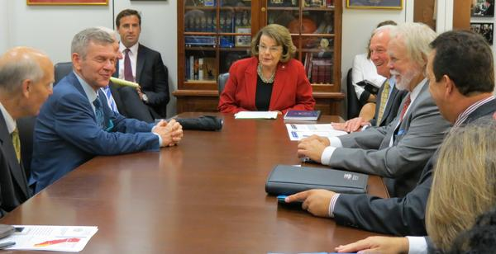
Meeting with Sen. Feinstein

Slide 11
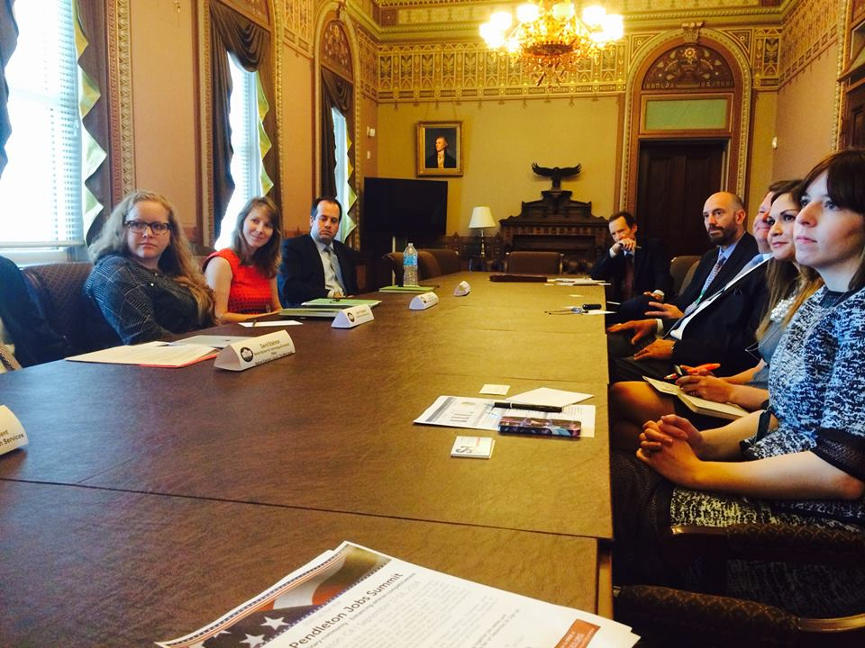
Meeting with Office of Public Engagement

Slide 12
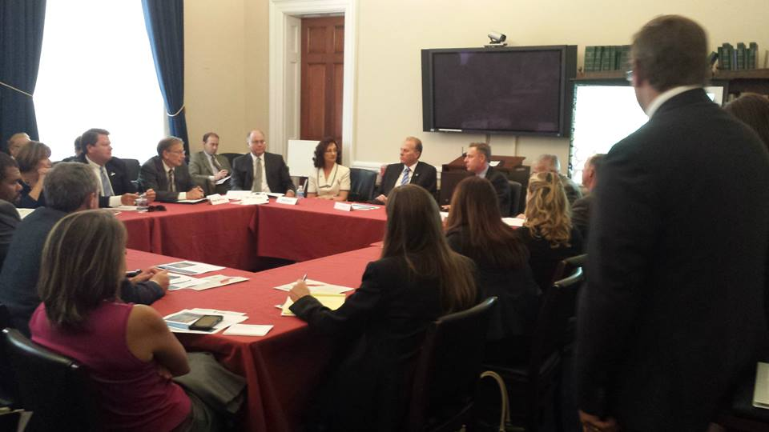
Water Roundtable

Slide 13
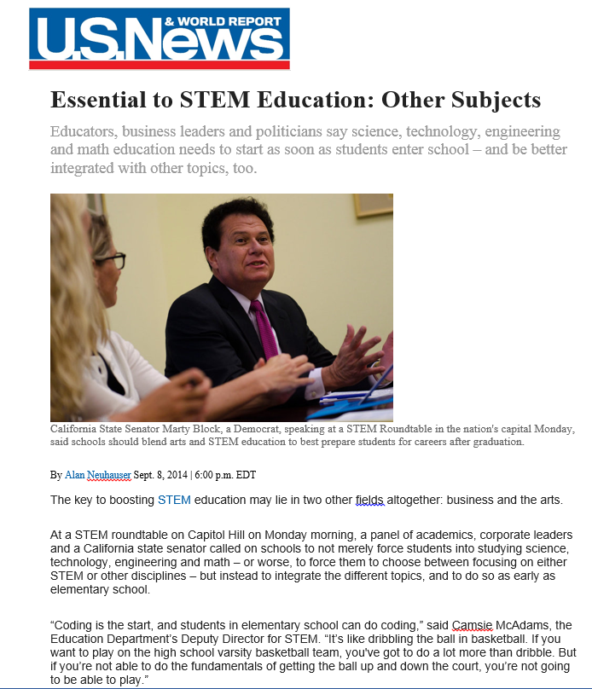
Media Coverage

Slide 14
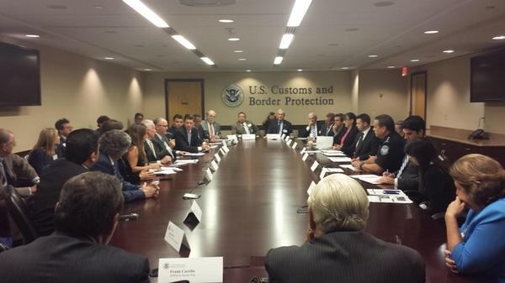
Meeting with Customs & Border Protection

Slide 15
Media Coverage

Slide 16

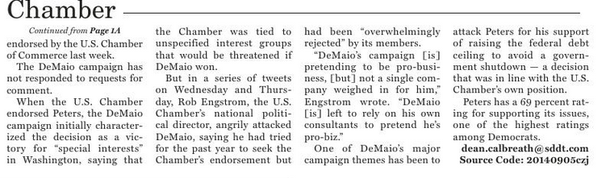
Media Coverage

Slide 17

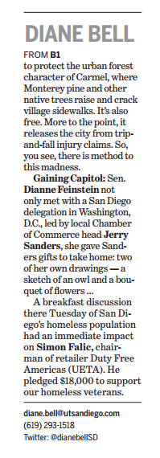
Media Coverage

Slide 18
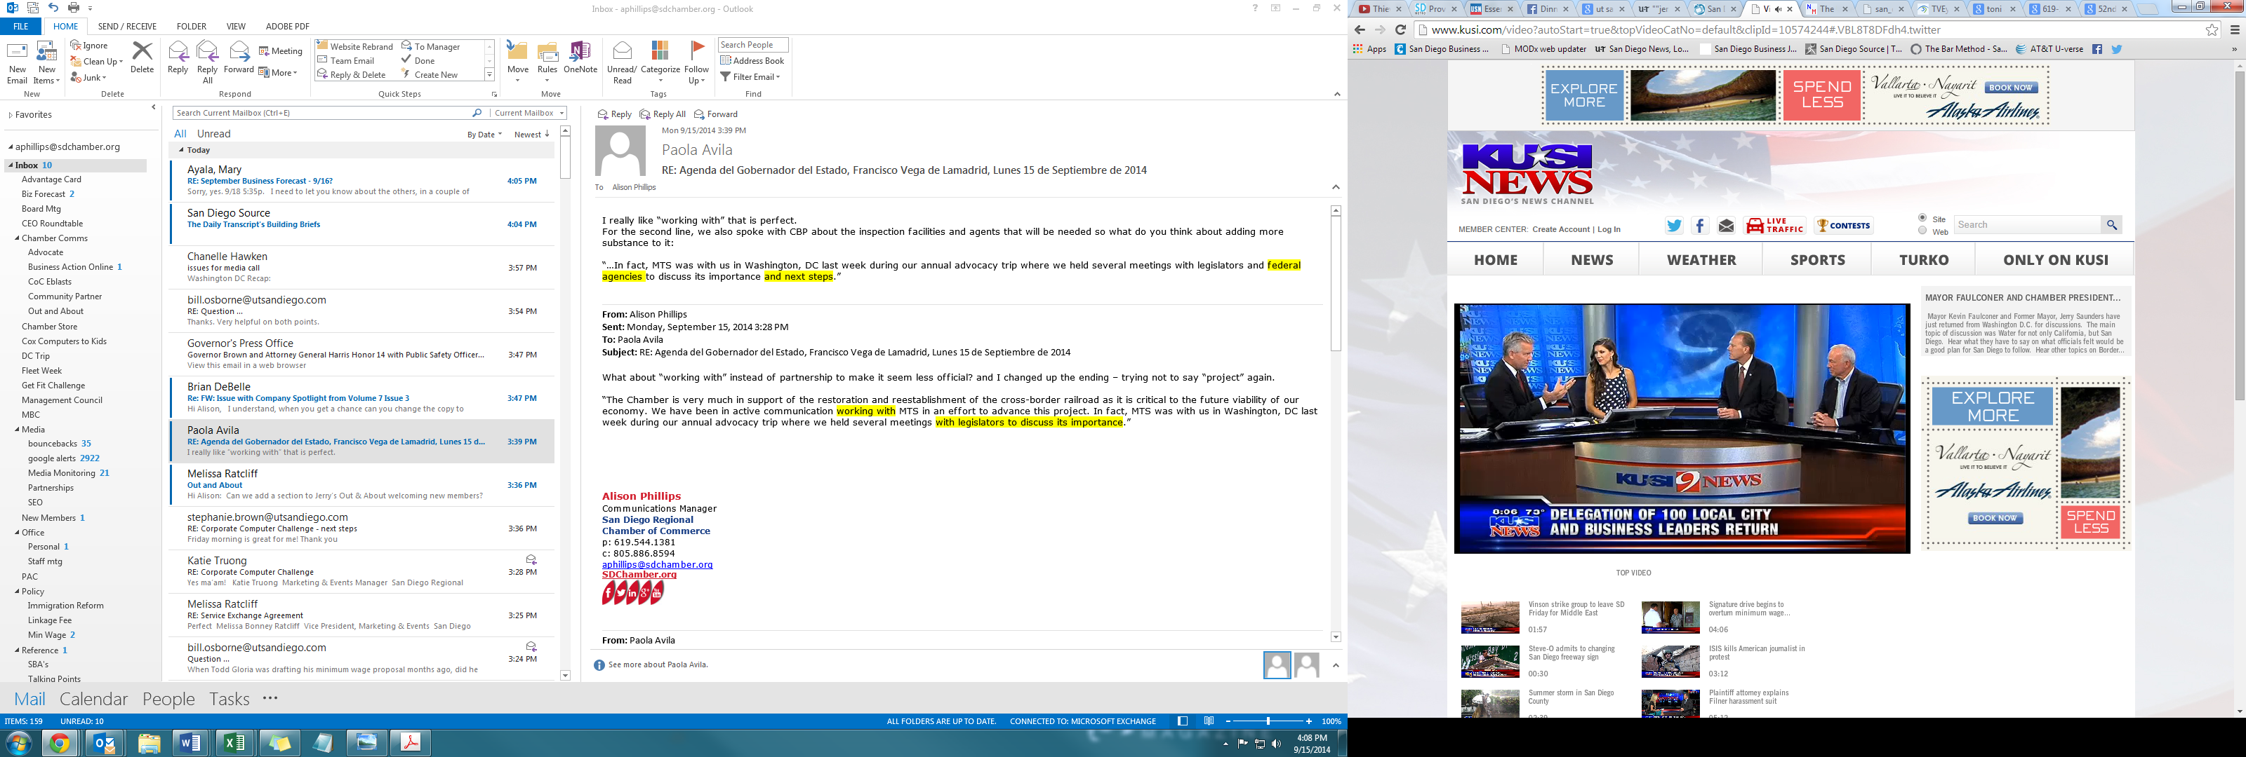
Media Coverage

Slide 19

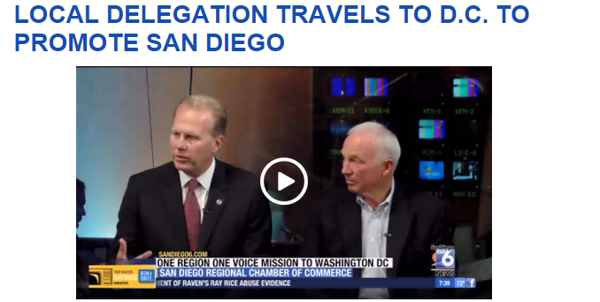
Media Coverage

Slide 20


Media Coverage

