Slide 1
North American Competitiveness and Innovation Conference
North American Borders in the
New Global Economy
San Diego, California, October 28, 2013

Slide 2
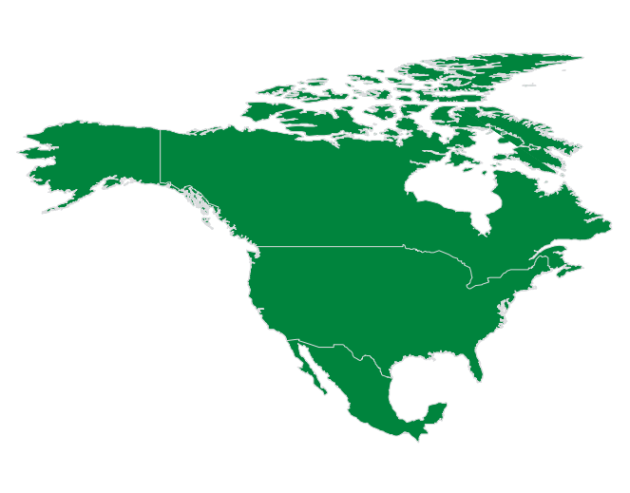
North American Borders in the New Global Economy
NAFTA Works
Almost 20 years ago, NAFTA responded to the challenges of the world economy: elimination of trade barriers, increasing investment opportunities, and establishing procedures for resolution of trade disputes.
And all that has worked.

Slide 3
Trade: NAFTA Achievements
North American Borders in the New Global Economy
Intra- regional commerce in North America
(billion dollars/% annual variation)
Trade Integration in North America 1993-2012
Trilateral commerce increased 265% since the start of NAFTA.
In 2012 trilateral trade reached a record $1.056 trillion dollars, increasing 4.3% from 2011.
Mexican participation in intraregional trade in 2012 was 18.5%.
The U.S., and Canada invested $166.5 billion dollars in Mexico between 1999 y 2012, which represents 54.5% of México´s total FDI.
Source: DGCREB-SRE, with data from Secretaría de Economía. The figures for 2010, 2011 y 2012 were taken from data from Statistics Canada, US Department of Commerce and Secretaría de Economía.
NAFTA has accelerated the economic integration and interdependence. Production chains on both sides of the border, and with Canada complement each other, and are becoming larger and more sophisticated.

Slide 4
North American Borders in the New Global Economy
Today and towards the future:
We need to develop a more integrated, prosperous and competitive region that meets the needs of our societies.
Quality of Life
Competitiveness
Region of Knowledge
Innovation

Slide 5
North American Borders in the New Global Economy
The potential is here: Our common border is one of the most dynamic in the world
The ten border States constitute the world’s 4th largest economy.
The total population of the border municipalities and counties, on both sides, is more than 14 million people.
One million people cross every day both ways, on the average.
The border has a key role on the commercial, economic and social development of our countries: more than 70% of the bilateral trade flows through our land ports of entry.

Slide 6
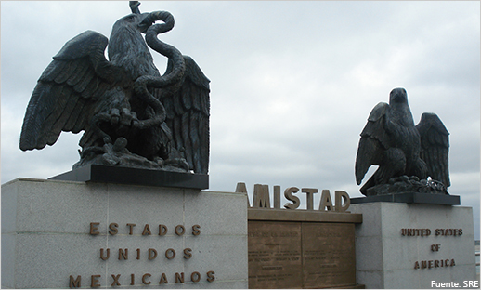
North American Borders in the New Global Economy
Challenges to transform North America into a competitive region:
The border region has experienced a loss of competitiveness due to long waiting times produced by increased security measures, beyond the saturation of ports of entry.
Several other factors (rising fuel prices, increasing wages in China, technological advances in production processes) are improving competitiveness in the border region.

Slide 7
North American Borders in the New Global Economy
What we ought to accomplish?
Reduce costs of transactions by means of expanding and modernizing existing border infrastructure to build world-class logistical capability, reduce border wait times, optimize customs procedures, and expand trusted traveler and shipper programs.
Enhance regional security through safe, efficient, rapid, and lawful movement of goods and people (Declaration of the 21st Century Border ).

Slide 8

North American Borders in the New Global Economy
The Border as a membrane:

Slide 9
New Regional Focus
North American Borders in the New Global Economy
Border trade and investment, attention to disputes, shared natural resources.
Links between societies
A shared vision
Security in North and Central America, multilateral cooperation.
Support for social and economic development in Central America, TPP, Pacific Alliance.
Education, México´s image abroad, immigration reform, human development and border sustainability, consular efficiency, empowerment of Mexicans
Innovation, knowledge, energy, infrastructure, shared prosperity, tourism
Attention to Mexicans, preventive protection, consular modernization, response to local bills.

Slide 10
North American Borders in the New Global Economy
New Focus:
Political Dialogue
Cooperation
Promotion
Links to Mexicans abroad
2. Improve Mexico´s image in the United States and Canada
3. 21st Century Border: safe, prosperous, sustainable and good quality of life
4. Empowered Mexican communities for fast and adequate integration to US society, linked to Mexico (bi-national actors, development actors)
1. New agenda: creating synergies for development
Competitiveness
Links between societies
Shared vision

Slide 11
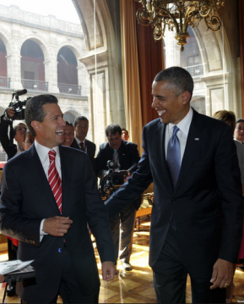
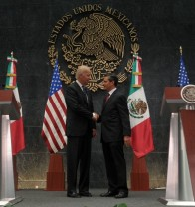
North American Borders in the New Global Economy
New Mechanisms: Generating Synergies
High Level Economic Dialogue (HLED).
Mexico – United States Entrepreneurship and Innovation Council (MUSEIC).
Bilateral Forum on Higher Education, Innovation and Research (FOBESII).

Slide 12
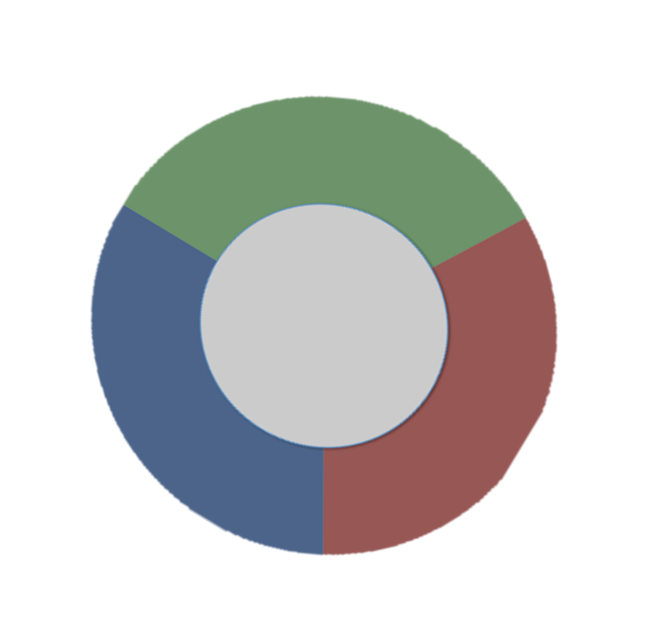
North American Borders in the New Global Economy
HLED
Innovation
and
Competitiveness
MUSEIC
FOBESII

Slide 13
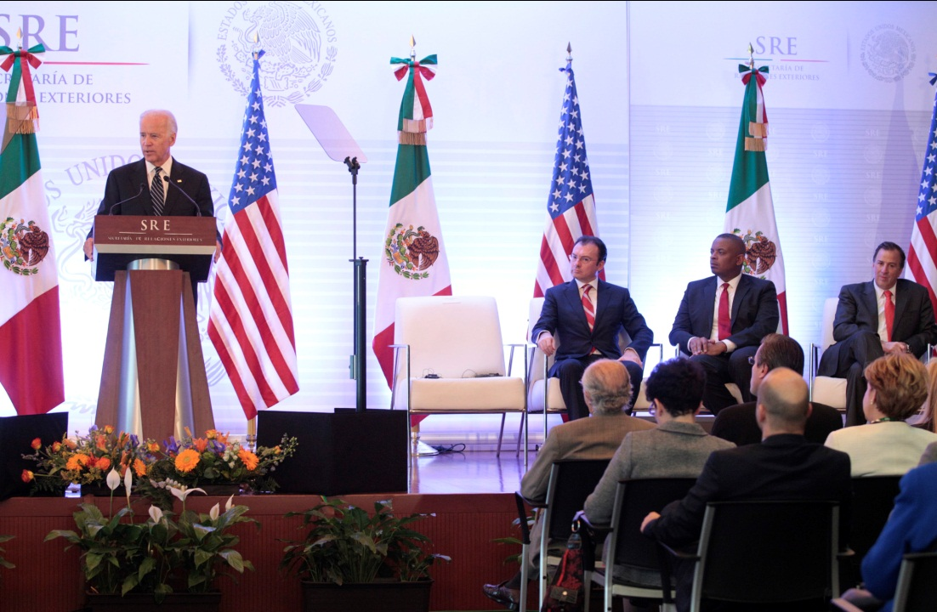
North American Borders in the New Global Economy
High Level Economic Dialogue (HLED)
The High Level Economic Dialogue was created by Presidents Peña Nieto and Obama in May 2013.
Its first meeting was held on September 20th, 2013 in Mexico City.
Vice President Joseph Biden led the U.S. delegation comprising four cabinet members and the U.S. Trade Representative.

Slide 14
North American Borders in the New Global Economy
High Level Economic Dialogue (HLED)
The HLED seeks to strengthen the dialogue between the governments and the private sector and civil society of the two countries.
Key areas
Objectives
Promoting Competitiveness and Connectivity
Fostering Economic Growth, Productivity, Entrepreneurship and Innovation
Partnering for Regional and Global Leadership
To strengthen and deepen economic and trade ties between the U.S. and Mexico to make North America, together with Canada, the most competitive region in the world: transportation systems, logistics corridors & freight planning; modernization and expansion of air transport relationship, among others
It identifies strategic sectors to implement actions and maintains a flexible approach to advance economic and trade strategic priorities: the border as a catalyst for development, comprehensive development strategy, joint investment promotion, and women
economic empowerment.
Underscore North America´s commitment in order to advance economic and social development and citizen security in the hemisphere (trade liberalization and priorities of mutual interest as NAFTA partners).

Slide 15
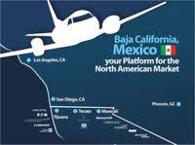
North American Borders in the New Global Economy
Mexico – United States Entrepreneurship and Innovation Council (MUSEIC)
Its creation was announced in May 2013. Its first meeting was held on September 12, 2013 in Mexico.
It aims to coordinate and collaborate on strategies to develop the ecosystem of entrepreneurship and innovation for entrepreneurs and companies from both countries.
Headed by Mexico’s Entrepreneurship National Institute and the U.S. State Department.
Seven working groups were established. SRE participates in three of them: Diaspora, iClusters and women empowerment.

Slide 16
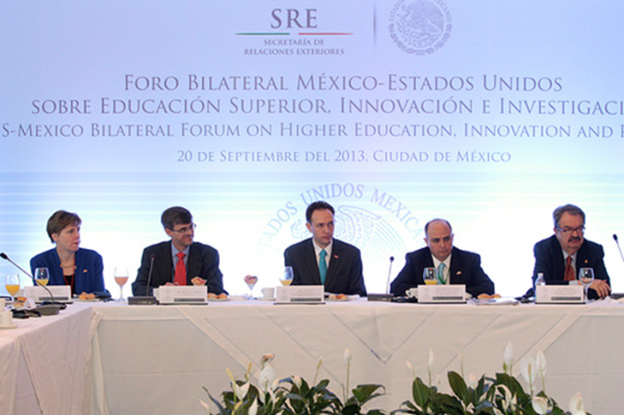
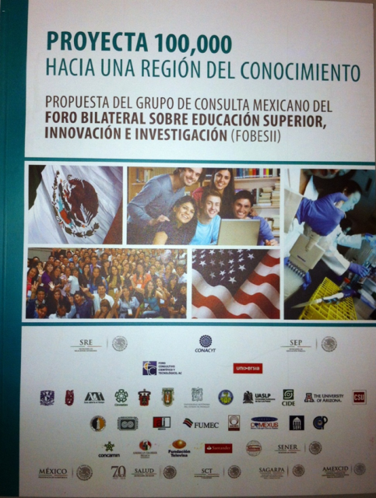
North American Borders in the New Global Economy
Bilateral Forum on Higher Education, Innovation and Research (FOBESII)
Mexico and the United States will work together to transform North America into a prosperous, competitive and inclusive region based on knowledge by boosting bilateral cooperation in higher education, innovation and scientific research.
The Forum seeks to promote economic development and mutual understanding between our countries through academic exchange programs, research and innovation in areas of joint interest.
Proyecta 100,000 goal is to have 100,000 Mexican students in the U.S. and 50,000 U.S. students in Mexico by the year 2018.
Bilateral research and innovation centers and projects.

Slide 17
North American Borders in the New Global Economy
North America Leaders Summit
It is a privileged forum to continue boosting initiatives that promote competitiveness in the region:
Regional Integration
Competitiveness and Connectivity
Social Inclusion, Productivity, Entrepreneurship, Innovation
Policy Coordination

Slide 18
North American Competitiveness and Innovation Conference
North American Borders in the
New Global Economy
San Diego, California, October 28, 2013

