Slide 1
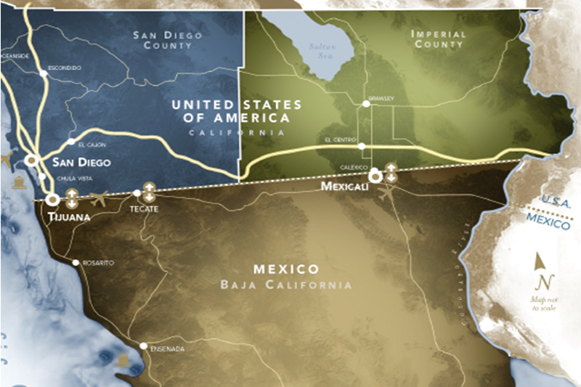
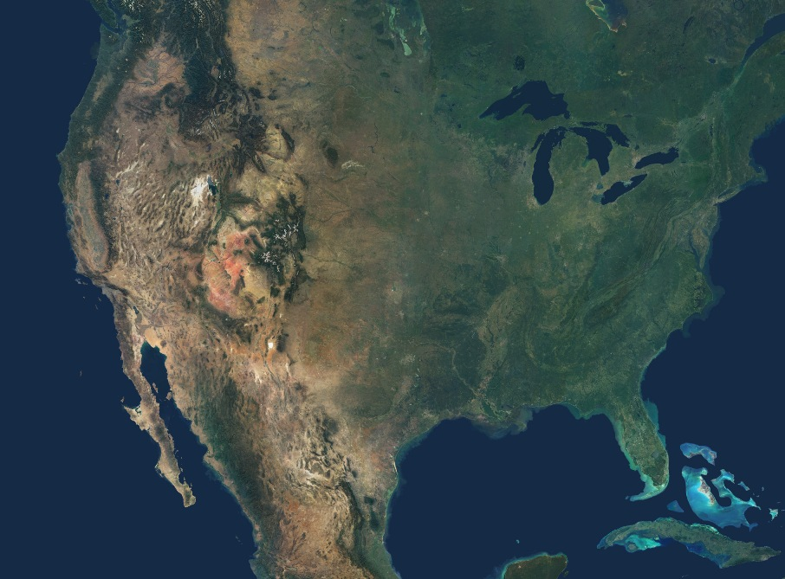
Cali Baja Mega-Region:
San Diego County, Imperial County, Tijuana, Mexicali, Tecate, Rosarito & Ensenada
By the numbers:
Population: 6.6 million
Labor force: 3.2 million
400,000 University+ students
GDP: $214 billion
3,600 advanced manufacturing companies
Notes:
Poblacion
Empleo
GDP

