Slide 1
BINATIONAL DATA
SAN DIEGO
TIJUANA

Slide 2
DEMOGRAPHICS
POPULATION
GDP
SAN DIEGO
3.3 Million
TIJUANA
1.9 Million
SAN DIEGO
$225 B
TIJUANA
$21 B
BINATIONAL REGION*
7.3 Million
BINATIONAL REGION*
$255 B
*San Diego, Imperial Valley, Baja California
Notes:
SOURCES:
Population
3.3 Million (spread across 18 cities). (2020) - Go Global: San Diego's Trade and Investment Initiative.
2.2 Million (2021) - https://www.macrotrends.net/cities/21871/tijuana/population
7.3 Million *San Diego, Imperial Valley, and Baja (2018) - USD, The CaliBaja Economy
GDP
$225 Billion (2022) – BEA
$21 Billion (2017) - https://usmex.ucsd.edu/_files/events/frontera-fridays/tijuana-regional-profile-2017.pdf
$255 Billion (2018) *San Diego, Imperial Valley, and Baja - TRADE AND COMPETITIVENESS IN NORTH AMERICA: A FOCUS ON THE CALI-BAJA REGION

Slide 3
ECONOMY
Top Industries
Emerging Sectors
SAN DIEGO
Biotech and Biopharma
Renewable Energy, Cleantech
Defense/Aerospace
SAN DIEGO
AI
Battery Technology
Bluetech
TIJUANA
Display manufacturing
Medical Device Manufacturing
Electronics Manufacturing
TIJUANA
Aerospace Manufacturing
Life Sciences & Software
E commerce logistics hub
Notes:
SOURCES:
Top Industries
Biotech, Biopharma, Renewable Energy, Cleantech, Defense/Aerospace (2022) - San Diego EDC
Display (Monitor and projector) manufacturing, Medical device manufacturing, Electronics Manufacturing (2020) - https://datamexico.org/en/profile/geo/tijuana
Emerging Sectors
Artificial Intelligence, Battery Technology, Bluetech (2022)...SDEDC --- (Canabis, Cyber Security, Maritime Technologies (2020) - https://www.sandiegomagazine.com/guides/coolest-companies/the-next-big-industries-in-san-diego/article_d6fd6b62-6579-5875-8d02-fa87dca0f45c.html )
Aerospace Manufacturing, Life Sciences & Software, Call Center Operations (2021) - https://tijuanaedc.org/foreign-investment-in-mexico/

Slide 4
Foreign Direct Investment
Total
Exports
SAN DIEGO
$24 Billion
TIJUANA
$20.5 Billion
SAN DIEGO
$3 Billion
TIJUANA
$1.1 Billion
Top Sources of FDI
Total Imports
SAN DIEGO: 94% comes through mergers and acquisitions
TIJUANA:
71% comes through the manufacturing industry
SAN DIEGO
$46 Billion
TIJUANA
$20.4 Billion
Notes:
SOURCES
FDI
$3 Billion (2020) - Go Global: San Diego's Trade and Investment Initiative
1.1 Billion (2022) - USD, The CaliBaja Economy
94 percent of all FDI comes through mergers and acquisitions (2021) - Go Global: San Diego's Trade and Investment Initiative
71 percent of all FDI comes through the manufacturing industry (2017) - https://usmex.ucsd.edu/_files/events/frontera-fridays/tijuana-regional-profile-2017.pdf
Exports
$24 Billion (2021) - US CENSUS BUREAU
$20.5 Billion (2020) - https://datamexico.org/en/profile/geo/tijuana?depthTradeValueSelector1=tradeOption0
Imports
$46 Billion (2020) - Go Global: San Diego's Trade and Investment Initiative
$20.4 Billion (2020) - https://datamexico.org/en/profile/geo/tijuana?depthTradeValueSelector1=tradeOption0

Slide 5
Top Exports
Top Imports
SAN DIEGO
Audio Visual Equipment
Semiconductors
Hardware
SAN DIEGO
Passenger Vehicles
Commercial Vehicles
Computer Chips
TIJUANA
Monitors and Projectors
Medical Devices
Motor Vehicle Parts
TIJUANA
Liquid Crystal Devices
Motor Vehicles Parts and Accessories
Other Machinery Parts
SAN DIEGO
#1 Mexico
#2 Canada
#3 China
TIJUANA
#1 United States
#2 Canada
#3 China
Top Trade
Partners
Notes:
SOURCES
Top Exports
Audio Visual Equiptment ($245 M), Semiconductors ($203 M), and Hardware ($69 M) (2018) - https://usmex.ucsd.edu/_files/072018_trade-and-competitiveness-report-english.pdf
Monitors and Projectors ($7.6 B), Medical Devices ($1.8 B), Motor Vehicle Parts ($960 M). (2020) https://datamexico.org/en/profile/geo/tijuana
Top Imports
Passenger Vehicles, Commercial Vehicles, & Computer Chips. (2020) - https://www.ustradenumbers.com/port/port-of-san-diego-calif/
Liquid Crystal Devices (US$2.94B), Motor Vehicles Parts and Accessories (US$1.58B), and Other Machinery Parts (US$1.26B). (2020) https://datamexico.org/en/profile/geo/tijuana
Top Trade Partners
#1 Mexico, #2 Canada, #3 China (2021) - https://www.census.gov/foreign-trade/statistics/highlights/toppartners.html
#1 United States, #2 Canada, #3 China (2020) - https://datamexico.org/en/profile/geo/tijuana

Slide 6
BORDER
1.37 MILLION
6.9
MILLION
Annual Northbound Truck Crossings
Annual US-Mexico Total Truck Crossings
(Otay Mesa & Calexico LPOE)
$6.2 B
$50 B
Annual Value of Commercial Crossings
Annual Regional Trade Across Ports of Entry
(Northbound + Southbound)
(Otay Mesa LPOE)
Notes:
SOURCES
1.37 Million (2021) – Dept of Transportation https://www.bts.gov/content/us-mexican-border-land-freight-gateways-number-incoming-truck-or-rail-container-crossings
6.9 Million (2021) - Dept of Transportation https://www.bts.gov/content/us-mexican-border-land-freight-gateways-number-incoming-truck-or-rail-container-crossings
$6.2 Billion (2018) - TRADE AND COMPETITIVENESS: IN NORTH AMERICA: A FOCUS ON THE CALI-BAJA REGION
$50 Billion (2021) -https://www.freightwaves.com/news/developers-capitalizing-on-booming-california-mexico-trade + GSA confirmed
Pending:
MX data on southbound truck crossings in Otay

Slide 7



AVERAGE MONTHLY BORDER CROSSINGS (NORTHBOUND)
3.3
MILLION
Travelers
1.6
MILLION
Passenger Vehicles
<700K
Pedestrians
* CBP San Diego Field Office Land Ports of Entry February 2023 Report, San Ysidro & Otay Mesa LPOE
Notes:
SOURCES
CBP San Diego Field Office Land Ports of Entry February 2023 Report (monthly shared at stakeholder meetings). Contact SDRCC for copies.
Pending:
Comparable data southbound.

Slide 8
COLLEGES & UNIVERSITIES
24
35
Top Institutions
UCSD
USD
SDSU
UABC
CETYS
ITT
UTT
SAN DIEGO
TIJUANA
9
Number of Colleges & Universities with Cross-Border Partnerships*
*Southwestern College, UCSD, USD, SDSU, UABC, UTT, CETYS, COLEF, IBERO
Notes:
SOURCES
24 Universities in San Diego - https://www.sandiego.org/articles/san-diego-universities-and-colleges.aspx
35 Universities in Tijuana – TJEDC
9 Colleges and Universities with Cross-border partnerships - https://sdchamber.org/wp-content/uploads/2023/04/Cali-Baja-infographic2017.pdf

Slide 9






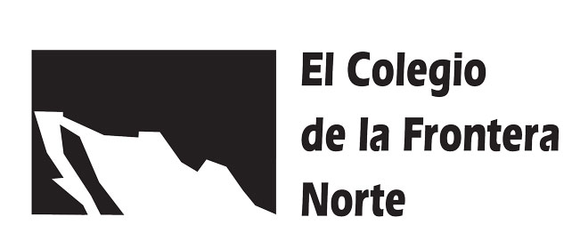
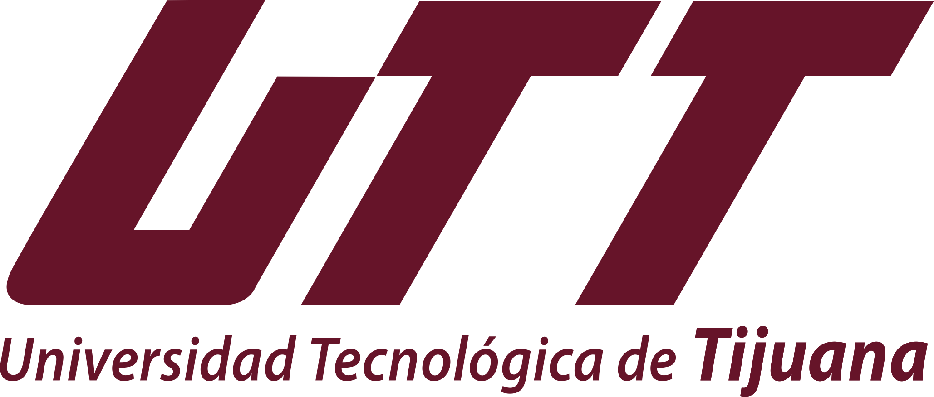
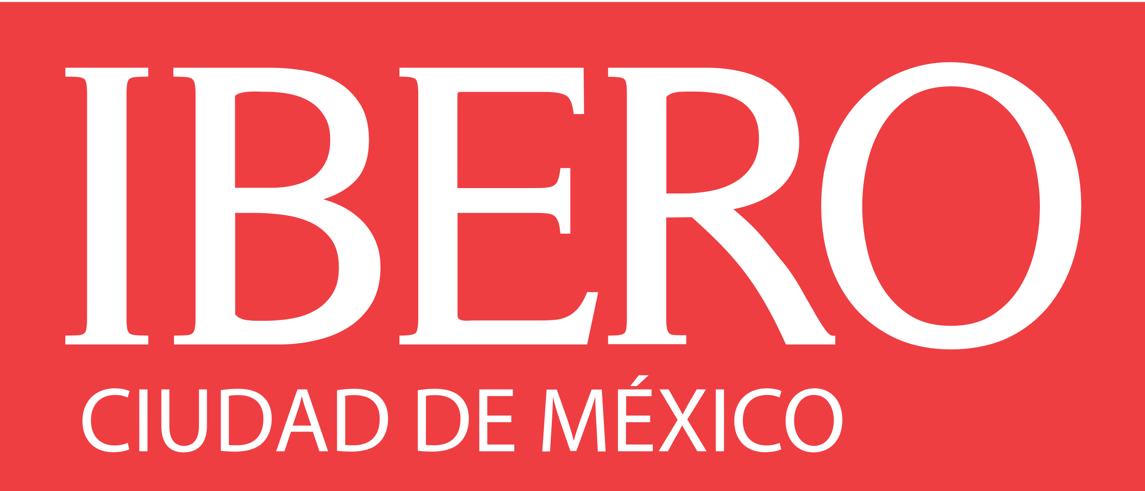
COLLEGES & UNIVERSITIES
Offers students the option to attend partner universities across the border
ENLACE bi-national summer program in science and engineering
Annual workshops on social innovation for USD and CETYS students
Non-binding memorandum of understanding (MOU) for collaborative learning across the border
UABC students can take classes at Southwestern for the same price as in-state students
UTT and Southwestern students can study at their partner universities across the border
Collaboration between COLEF'S Doctorate in Social Sciences and UCSD' Center for U.S.–Mexican Studies
Students can take a semester or up to a full year at the University of San Francisco
MBA double-degree between USD and CETYS
Notes:
SOURCES:
SOUTHWESTERN: https://news.swccd.edu/2015/02/southwestern-college-strengthens-cross-border-connections/
UC SAN DIEGO: https://summer.ucsd.edu/program-finder/enlace.html
UNIVERSITY OF SAN DIEGO: https://www.sandiego.edu/news/detail.php?_focus=82977
SDSU: https://newscenter.sdsu.edu/sdsu_newscenter/news_story.aspx?sid=78251
UABC: https://www.sandiegouniontribune.com/en-espanol/primera-plana/articulo/2022-03-14/southwestern-college-anuncia-acuerdos-con-universidades-en-baja-california
CETYS: https://www.cetys.mx/gsb/en/double-degree-2/
UTT: https://laprensa.org/us-state-department-recognizes-technological-university-tijuana
COLEF: https://www.colef.mx/noticia/se-reanuda-colaboracion-entre-el-colef-y-ucsd/
IBERO: https://ibero.mx/prensa/presentan-ibero-y-universidad-de-san-francisco-nueva-maestria-en-estudios-sobre-migracion

Slide 10
TOURISM
Annual Visitors
Visitor Spending
SAN DIEGO
28.8 Million
TIJUANA
11 Million
SAN DIEGO
$13.6 B
TIJUANA
$1.7 B
HOTEL OCCUPANCY
72.6% (San Diego County)
HOTEL OCCUPANCY
69.77%
Notes:
From SDTA:
28.8M visitors to San Diego (57% stayed over night and 43% came from outside of the U.S./MX)
$13.6B visitor spending (17% above 2019 level of $11.6B due to longer length of stay and overall higher consumer prices)
10.8M enplanements at SD Airport (below 12.6M in 2019 due to fewer corporate travelers)
200K leisure & hospitality employees (back to pre-pandemic levels)
72.6% SD County hotel occupancy
From COTUCO:
11M visitors to Tijuana (75% foreign visitors, 25% domestic)
$1.7B (pesos) visitor spending (14.07% lower than 2019 level)
In 2022, COTUCO organized 43 conventions and events with 20K+ in attendance ($526M pesos in visitor spending)
TJ Airport reports over 78K operations movilizing 12.2M passengers
78,198 operations movilizing 12,267,382 passengers
69.77% Tijuana hotel occupancy
PENDING:
During the meeting COTUCO mentioned 90% but need confirmation as it differs from the report emailed to SDRCC.
Medical tourism stats
From CBX:
4.24 travelers utilized CBX in 2022

Slide 11
San Diego is a top 10 services exporter among U.S. metros
#1 Medical Device Cluster in the world
9 Ports of entry (7 land, 2 sea)
#4 Busiest Land Border Crossing in the World
#1 Busiest Land Border Crossing in the Western Hemisphere
Notes:
SOURCES:
San Diego is a top 10 services exporter among U.S. metros. - San Diego Go Global, 2021
#1 largest medical device cluster in the world (2018) - TRADE AND COMPETITIVENESS: IN NORTH AMERICA: A FOCUS ON THE CALI-BAJA REGION
#4 Busiest Land Border Crossing in the World*
#1 Busiest Land Border Crossing in the Western Hemisphere*
* Working to update these – findings so far include that the Malaysa-Singapore border processes up to 400,000 travelers daily during holidays, with 1 million crossing at the land checkpoints over the Good Friday weekend in 2019 alone (waiting on the stat for this year). San Ysidro processes up to 70,000 passenger vehicles and 20,000 pedestrians every day.

